Slide 1
Waleej Haider
Chapter 15
Connecting LANs,
Backbone Networks,
and Virtual LANs

Slide 2
Outline
Network Connecting Devices
  Repeater/Hub/Bridge/Router/Gateway
Backbone Network
  Bus/Star/VLAN

Slide 3
Network Devices
As Organizations grow, so do their networks
  Growth in number of users
  Geographical Growth
Network Devices :
  Are products used to expand or connect networks.
  Can control the amount of traffic on a network.
  Can speed up the flow of data over a network.
  Manage data transfer

Slide 4
Network Devices
End user devices or hosts
    Hosts are devices that connect directly to a network segment. It includes: Computers (Client / Servers), Printers, Scanners, etc.
Network Devices:
    Include all devices that connect the end-user devices to allow them communicate. (Repeater, Hub, Bridge, Router, Gateway)

Slide 5
Connectivity Devices
Each topology and network architecture has its limits.
Networks can not be expanded by simple adding more servers or cabling
Connectivity devices are the basic building blocks of network expansion

Slide 6
Connectivity Devices
Are used to connect separate segments of the network or inter-network
A segment is a portion of the network transmission media that is assigned a network address.

Slide 7
Devices to Expand the Network
11
Repeaters
Bridges
Switches
Hubs
Routers
Gateway

Slide 8
Network Connectivity Devices
Repeaters
Hubs
Bridges
Switches

Slide 9
Internetwork Connectivity Devices
Routers
Gateways

Slide 10

Five Categories of Network Devices

Slide 11
Five Categories of Network Devices
The five categories contain devices which can be defined as
  1. Those which operate below the physical layer such as a passive hub.
  2. Those which operate at the physical layer (a repeater or an active hub).
  3. Those which operate at the physical and data link layers (a bridge or a two-layer switch).
  4. Those which operate at the physical, data link, and network layers (a router or a three-layer switch).
  5. Those which can operate at all five layers (a gateway).

Slide 12
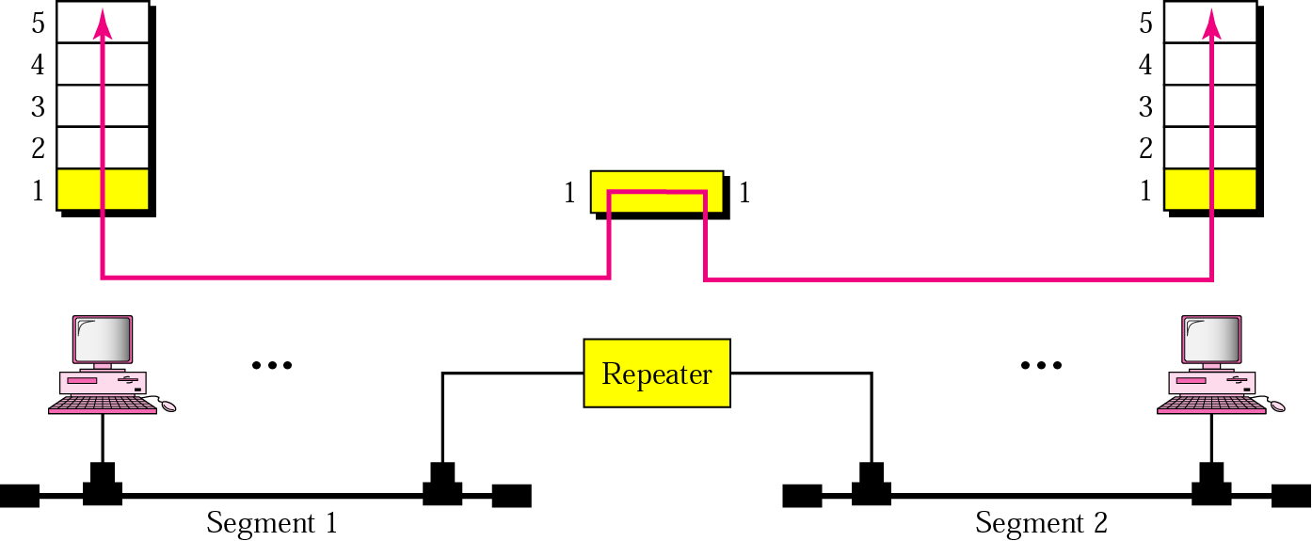
Repeater
A repeater connects segments of a LAN.
A repeater forwards every frame – there is no filtering.
A repeater is a regenerator, not an amplifier.

Slide 13
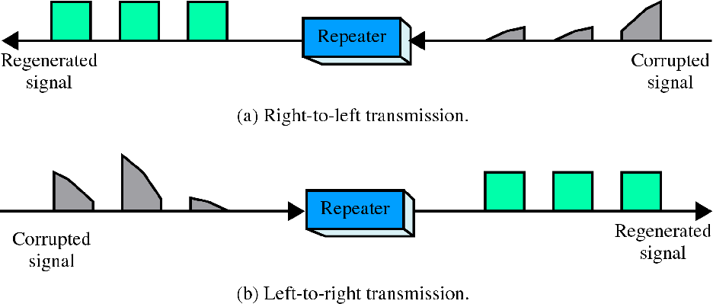
Function of repeater
Repeater is not exactly as same as Amplifier

Slide 14
Repeaters
A repeater can be used to increase the length of your network by eliminating the effect of attenuation on the signal.
Repeaters repeat signals
  Clean and boost digital transmission
  Analog networks use amplifiers to boost signal
It connects two segments of the same network, overcoming the distance limitations of the transmission media.

Slide 15
Repeaters
Some repeaters also serve as transmission media adapters, connecting two different types of media.
Repeaters can connect segments that have the same access method. (CSMA/CD, Token Passing, Polling, etc.)
It cannot reformat, resize, or manipulate the data
Physical layer (layer 1) device

Slide 16
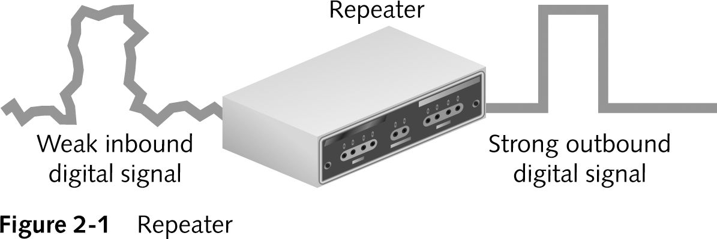
Repeaters (continued)

Slide 17
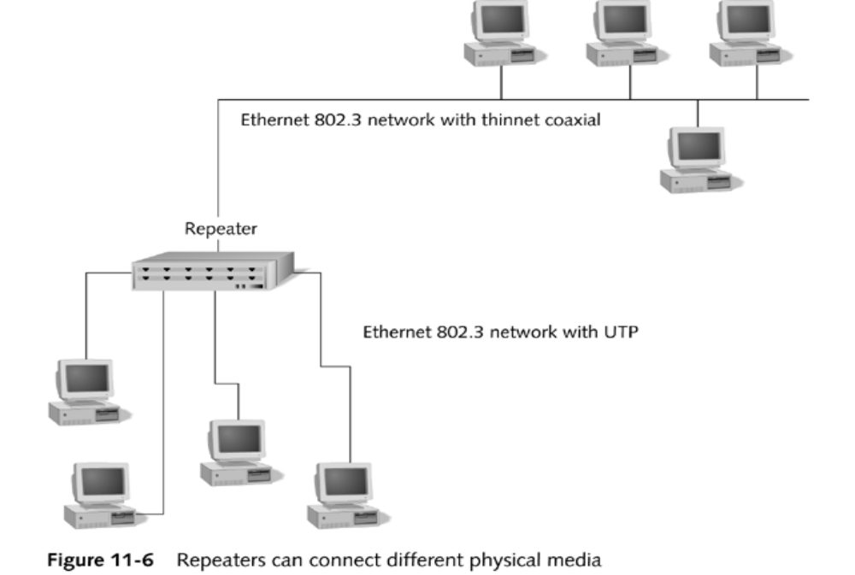
Repeaters
11
Figure11-6

Slide 18
Advantages Of Repeaters
Extend network physical distance
Do not seriously affect network performance
Special repeaters connect different media
  Copper to fiber

Slide 19
Disadvantages Of Repeaters
Cannot connect different network architectures
  Token Ring and Ethernet (Star)
Cannot reduce network traffic
Repeaters do not filter data
Do not segment (divide) the network
  Repeat everything without discrimination
Number of repeaters must be limited

Slide 20
Hubs
A hub is the place where data unites from one or more directions and is forwarded out in all directions.
Seen in local area networks
Generic connection device
  Physical layer
Notes:
Nowadays you see hubs with switches; but basically the hub is the place where data comes together while the switch determines how and where data is forwarded from the place where data comes together.

Slide 21
Hubs (continued)
In a star architecture, each node is connected to a central device called a hub. The hub takes a signal that comes from any node and passes it along to all the other nodes in the network.
A hub does not perform any type of filtering or routing of the data.
A hub is a junction that joins all the different nodes together.
Hubs are referred as Concentrators or multi-port repeater
Notes:
A hub does not perform any type of filtering or routing of the data. A hub is a junction that joins all the different nodes together.

Slide 22
Hubs
Regenerate and repeat signals
Broadcast signals through the network
Can not filter network traffic
Can not determine the best path
Are used as network concentration (focal) points.
Below the physical layer.

Slide 23
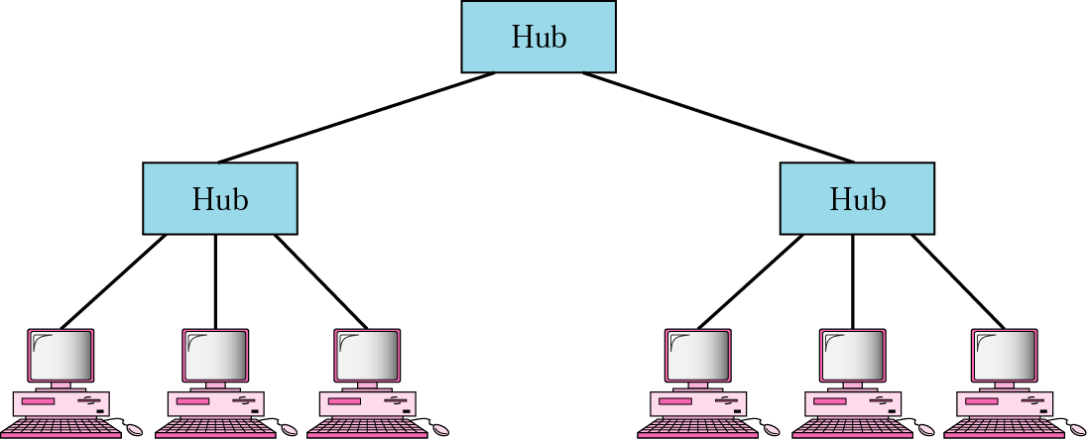
Hub
A hub is a multi-port repeater, used in star-wired or in tree LANs
Because of the amount of traffic and collisions, hubs can only be used in small network configurations.

Slide 24
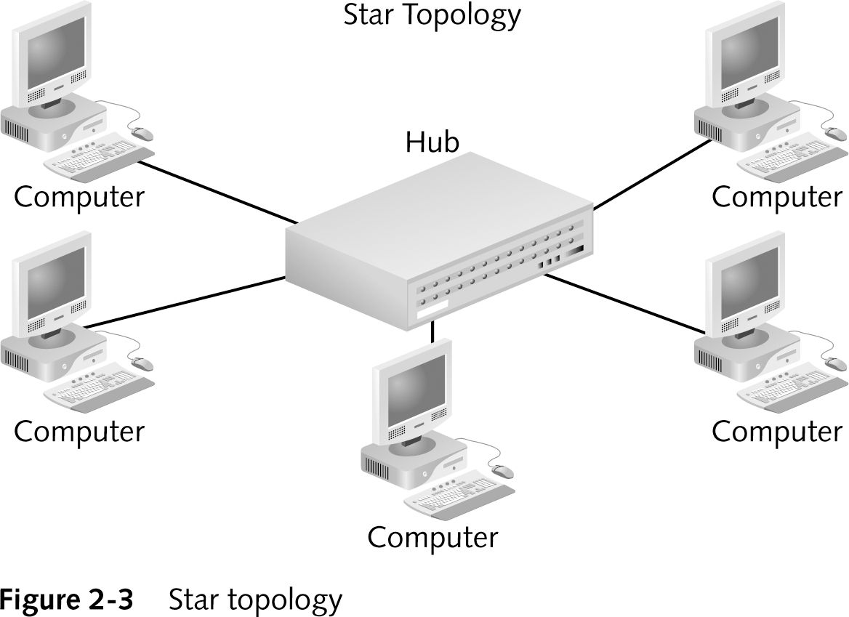
Hubs (continued)

Slide 25
Types of Hubs
Passive Hubs
Active Hubs
Intelligent Hubs (Switches)

Slide 26
Passive Hub
It functions only as a connection point for the signals
The signal pass through a passive hub without regeneration or amplification.

Slide 27
Active Hub
It regenerates or amplifies the signal before they are retransmitted.
Also called Multiport repeaters
Drawback:
  The noise is also regenerated

Slide 28
Multiple Access
When nodes or stations are connected and use a common link, called a multipoint or broadcast link, we need a multiple-access protocol to coordinate access to the shared link
Problems occur with too many nodes on the same network segment or collision domain with shared link or medium
Carrier Sense Multiple Access with Collision Detection (CSMA/CD) protocol, for example may be used as multiple-access protocol to access a shared medium
In this method, a station monitors the medium after it sends a frame to see if the transmission was successful. If so, the station is finished. If, however, there is a collision, the frame is sent again.

Slide 29
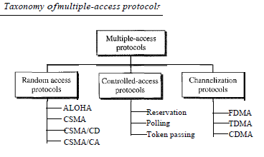
Multiple-Access Protocols

Slide 30
Network Segmentation
Segment - Any portion of a network that is separated, by a switch, bridge or router, from other parts of the network.
Segmentation
  Collisions and retransmissions are reduced
  Contention for bandwidth is reduced
Contention
  Stations compete with one another to access the medium
Collision
  In a random access method, each station has the right to the medium without being controlled by any other station.
  If more than one station tries to send, there is an access conflict called collision and the frames will be either destroyed or modified.
  To avoid access conflict or to resolve it when it happens, each station follows a procedure called Back off algorithm

Slide 31
Back off algorithm
we need to resend the frames that have been destroyed during transmission.
As collision involves two or more stations, if all these stations try to resend their frames after the time-out, the frames will collide again.
Pure ALOHA protocol dictates that when the time-out period passes, each station waits a random amount of time before resending its frame. The randomness will help avoid more collisions. We call this time the back-off time T_{B}.

Slide 32
Back off algorithm….
The pure ALOHA protocol relies on acknowledgments from the receiver.
When a station sends a frame, it expects the receiver to send an acknowledgment.
If the acknowledgment does not arrive after a time-out period, the station assumes that the frame (or the acknowledgment) has been destroyed and resends the frame.

Slide 33
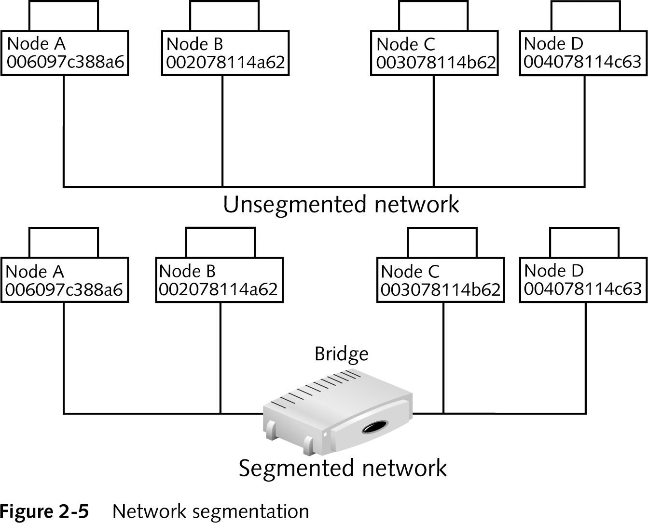
Network Segmentation (continued)

Slide 34
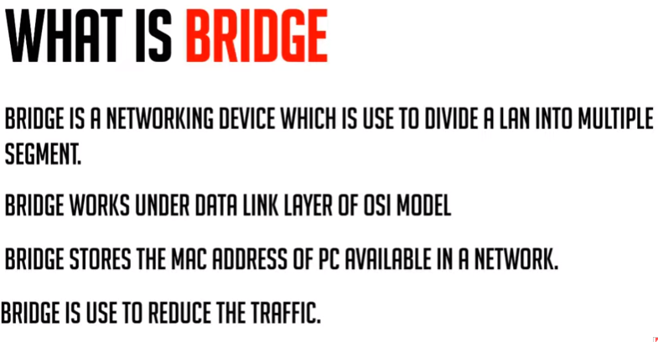


Slide 35
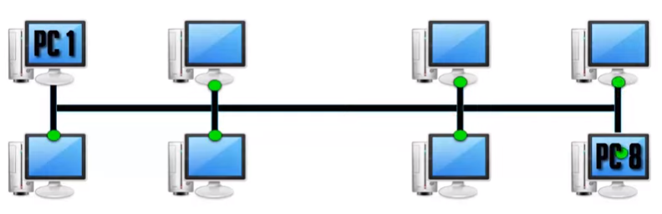
How LAN Works
ISSUE and its solution
If pc1 wants to send data to Pc8, it need to broadcast to all the nodes.

Slide 36
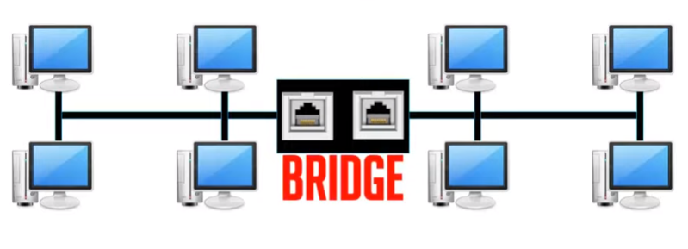

Slide 37
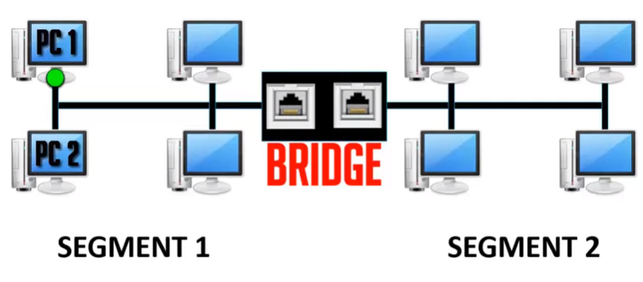
Pc1 wants to communicate pc2

Slide 38
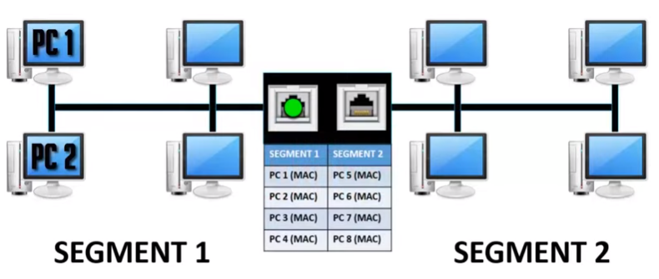

Slide 39
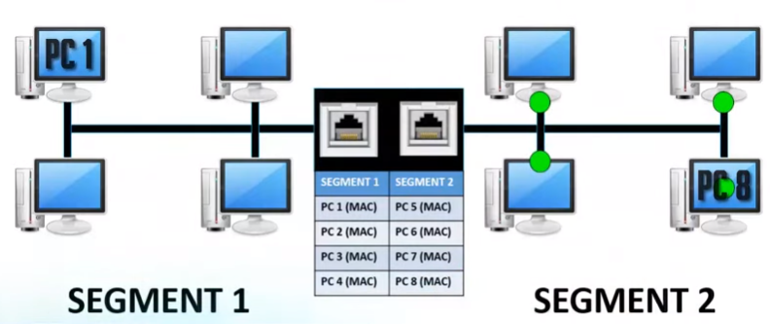

Slide 40
Bridges
11
can check the destination address of a frame and decide if the frame should be forwarded or dropped.
Divide a network into segments and filter traffic to avoid collision domain.
Limit or filter traffic keeping local traffic local, yet allow connectivity to other parts (segments)
Make decision based on the MAC address list
Connect different architectures and Forward packets between architectures: Ethernet & Token-Ring.

Slide 41
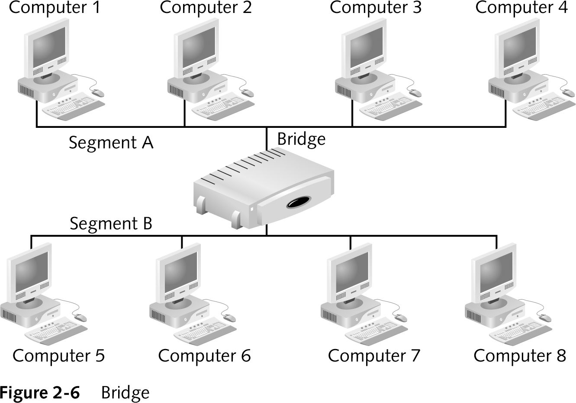
Bridges (continued)
Layer 2 (Data Link Layer) device

Slide 42
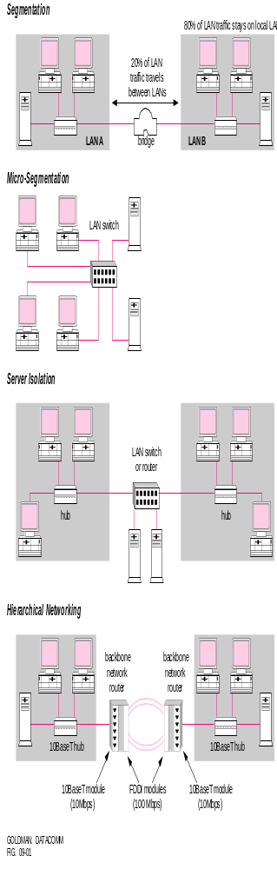
Bridges

Slide 43
Bridges
11
Read network addresses at the MAC (Media Access Control) sub-layer
Decide which segment address is on
Bridge has filtering capability
It can check the destination address of a frame and decide if the frame should be forwarded or dropped.
If the frame is to be forwarded, the decision must specify the port. A bridge has a table that maps addresses to ports.

Slide 44

A bridge has a table used in filtering decisions.

Slide 45
Translation Bridges
Connect networks with different network architecture
Example:
  Token ring connecting to Ethernet

Slide 46
Advantages And Disadvantages Of Bridges
Advantages of using a bridge
  Extend physical network
  Reduce network traffic with minor segmentation
  Creates separate collision domains
  Reduce collisions
  Connect different architecture

Slide 47
Advantages And Disadvantages Of Bridges (continued)
Disadvantages of using bridges
  Slower than repeaters due to filtering
  Do not filter broadcasts
  Broadcast packages are passed across bridges.
  More expensive than repeaters

Slide 48
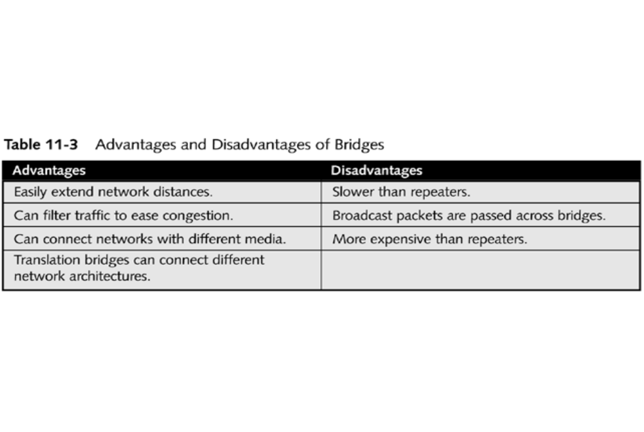
Bridges
11

Slide 49
Assignmemt
Describe learning bridge and explain the process of learning.
How Loop problem occurs in a learning bridge and how it can be eliminated

Slide 50
Switches
A switch is classified in two categories
  Two-layer switch
  Three-layer switch.
A three-layer switch is used at the network layer; it is a kind of router.
A two-layer switch performs at the physical and data link layers.
A two-layer switch is a bridge; a bridge with many ports and a design that allows better performance.
Whereas a bridge with a few ports can connect a few LANs
Modes of switching Store and forward, cut through ( no error checking, so fast), fragment free (check first 64 bytes where addressing stored) , adaptive (select one of these) switching
Notes:
Modes of switching Store and forward, cut through ( no error checking, so fast), fragment free (check first 64 bytes where addressing stored) , adaptive (select one of these) switching

Slide 51
2-Layer Switches
A 2-Layer switch is an N-segment bridge where each station has its own dedicated segment.
  Each link becomes a separate segment on the LAN.
Forwards frames to their destination based on the physical (MAC) address
Has the ability to buffer frames in order to manage traffic more efficiently.

Slide 52

N-segment bridge is a 2-layer Switch

Slide 53
Cont..
A high speed multiport bridge
Replacing repeaters & hubs in UTP
Dedicated bandwidth to each port, making data transmission more efficient.
Each port can use full 10/100/1000 Mbps.
Increase network performance
Virtual circuits between source and destination
Micro segmentation

Slide 54
Cont..
Between two computers using a switch two collision domains are created each with dedicated bandwidth
Between two hubs using a switch two collision domains are created each with shared bandwidth
Filter based on MAC addresses
Build MAC table

Slide 55
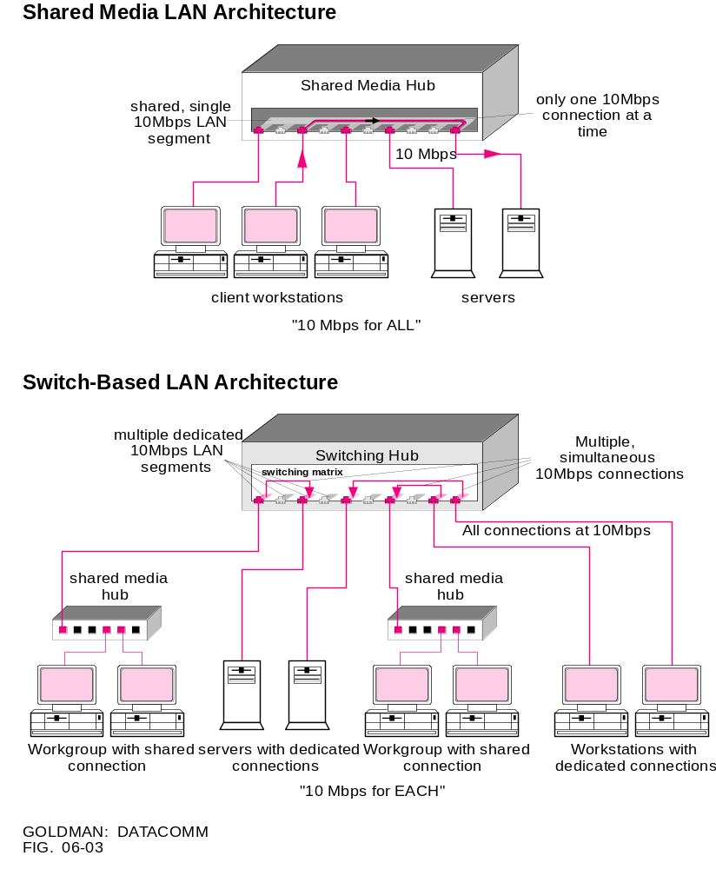
Switches

Slide 56
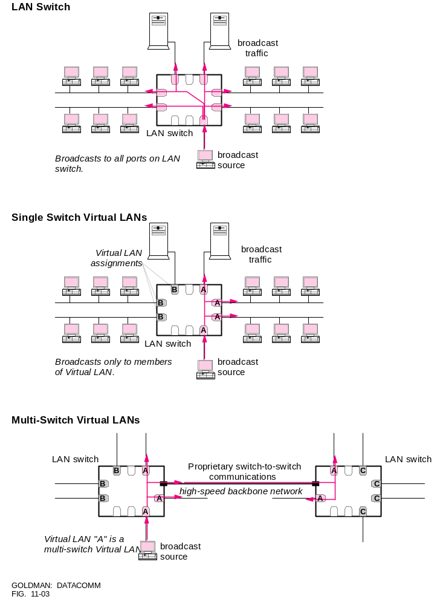
Switches

Slide 57
Switches (continued)
Advantages of switches
  Increase available network bandwidth by reducing its workload, computers only receive packets intended for them specifically
  Increase network performance
  Smaller collision domains

Slide 58
Switches (continued)
Disadvantages of switches
  More expensive than hubs and bridges
  Difficult to trace network connectivity problems through a switch
  Does not filter broadcast traffic

Slide 59
3-Layer Switch: The Router
Operates at the Network layer
Connects LANs and WANs.
Create a routing table to determine how to forward packets
  Packets (datagrams) are forwarded using logical addresses (IP addresses).
  Routing table can be updated dynamically or manually.
  Routing tables are normally dynamic and are updated using routing protocols.

Slide 60
Routers
Its purpose is to:
  examine incoming messages (layer 3 data),
  choose the best path for them through the network, and
  switch them to the proper outgoing port.
They don’t allow bad data or broadcast storm to be passed on the network
Provide filtering and network traffic control based on logical addresses

Slide 61
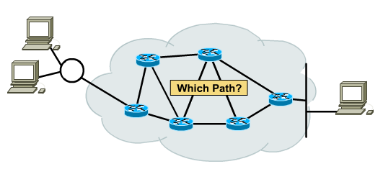
Routing Principle
Goal: Arriving at the destination
Considerations:
  Direct route (shortest)
  Reliable route
  Cheap route
  Safe route

Slide 62
Routers (cont..)
Connect multiple segments and networks
Multiple routers create an “internetwork”
Have become the backbone for the Internet, running the IP protocol.
They can connect networks using the same protocol but different network architectures.
Connect different layer 2 technologies (ethernet, Token Ring, FDDI, etc.)

Slide 63
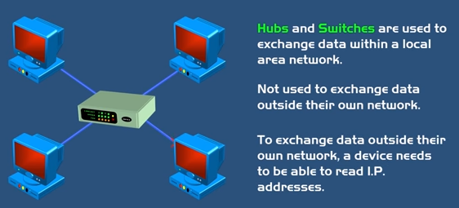
Difference

Slide 64
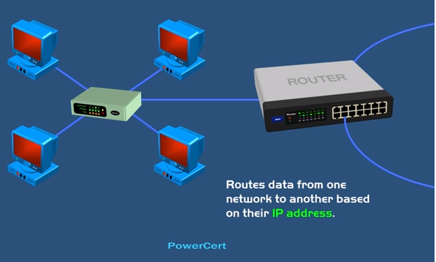
Router

Slide 65
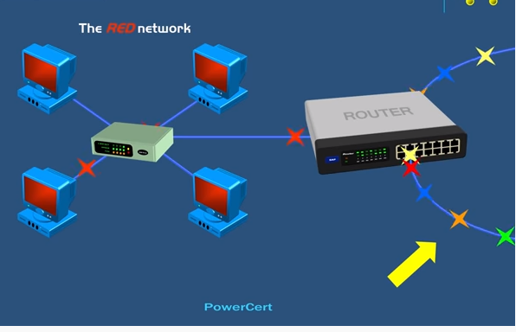

Slide 66
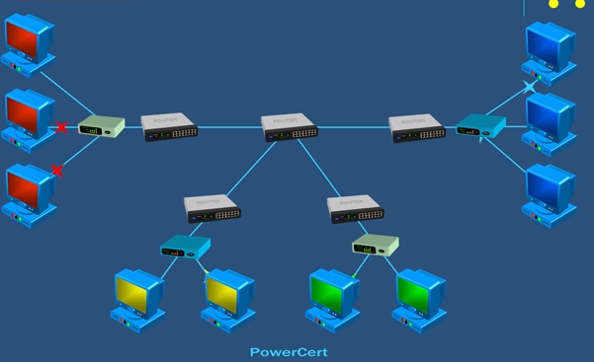

Slide 67
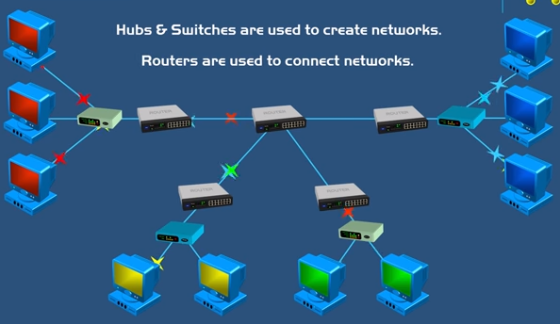

Slide 68

Routers connecting independent LANs and WANs

Slide 69
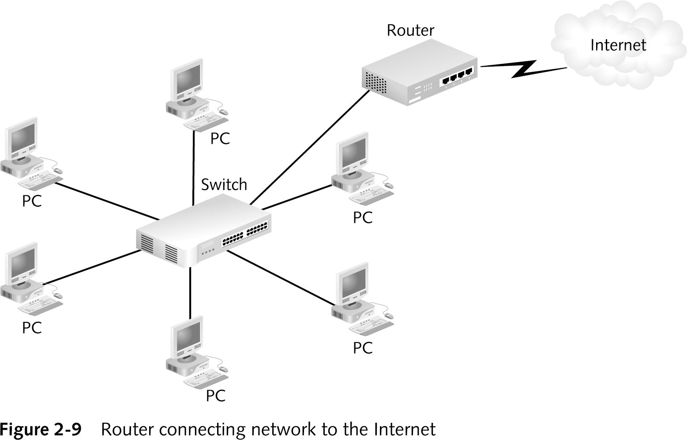
Routers (cont..)

Slide 70
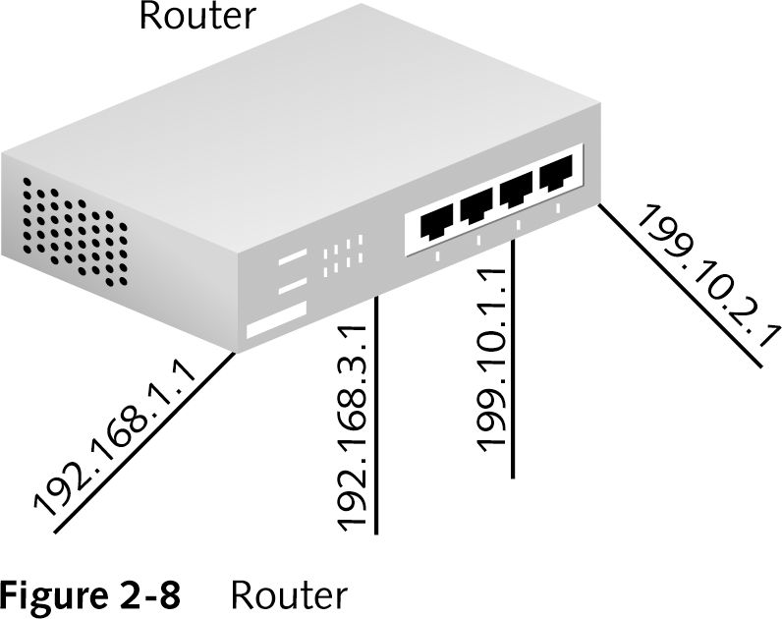
Different IP addresses at each port showing connections of different network segments

Slide 71
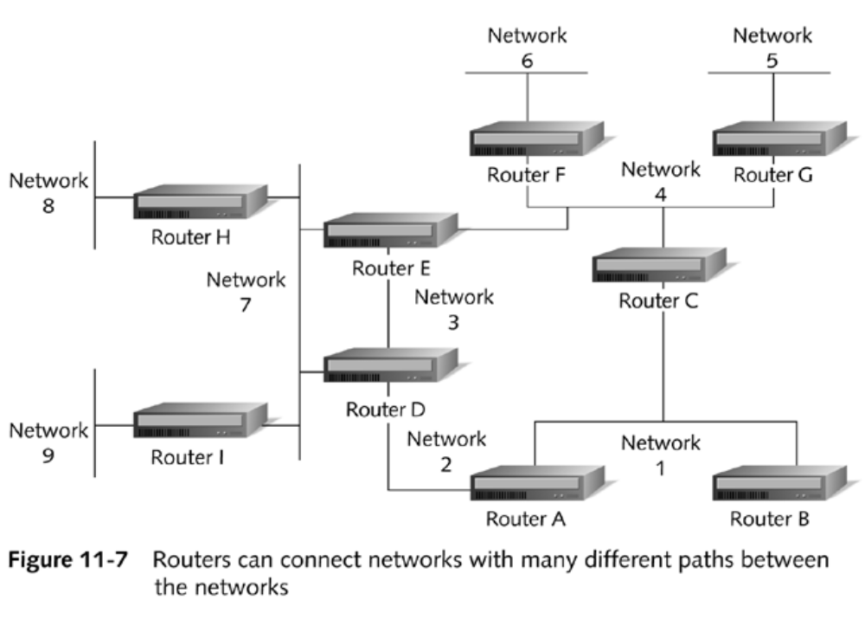
Routers

Slide 72
Advantages And Disadvantages Of Routers
Advantages of routers
  Can connect networks of different architecture
    Token Ring to Ethernet
  Choose best path through or to a network
  Create smaller collision domains
  Create smaller broadcast domains

Slide 73
Advantages And Disadvantages Of Routers (continued)
Disadvantages of routers
  Only work with routable protocols such as RIP, OSPF, or BGP
  More expensive than hubs, bridges, and switches
  Routing table updates consume bandwidth
  Increase delay due to a greater degree of packet filtering and/or analyzing

Slide 74
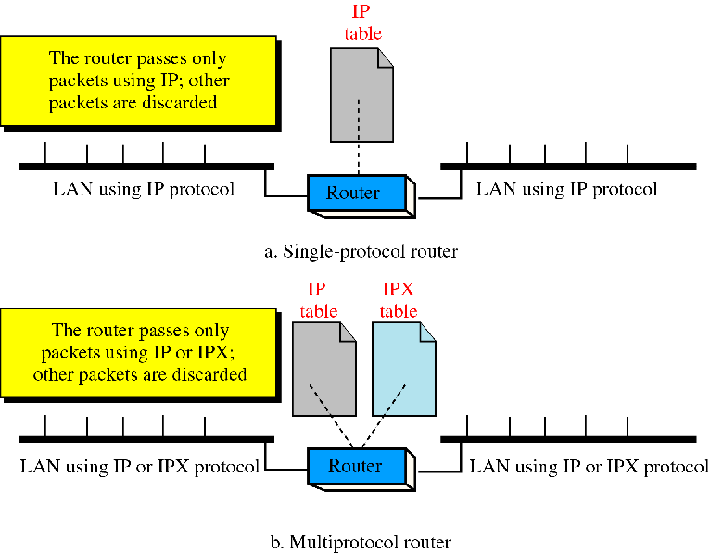
Single VS. Multiprotocol router

Slide 75
IPX/SPX
IPX/SPX stands for Internetwork Packet Exchange/Sequenced Packet Exchange.
IPX and SPX are networking protocols used primarily on networks using the Novell NetWare operating systems
IPX and SPX both provide connection services similar to TCP/IP, with the IPX protocol having similarities to IP, and SPX having similarities to TCP
IPX is a network layer protocol, while SPX is a transport layer protocol similar to TCP/IP.
The SPX layer sits on top of the IPX layer and provides connection-oriented services between two nodes on the network.

Slide 76
Brouters
Hybrid device
Functions as a router for routable protocols
Functions as a bridge for non-routable protocols
Operates at Data Link and Network layers

Slide 77
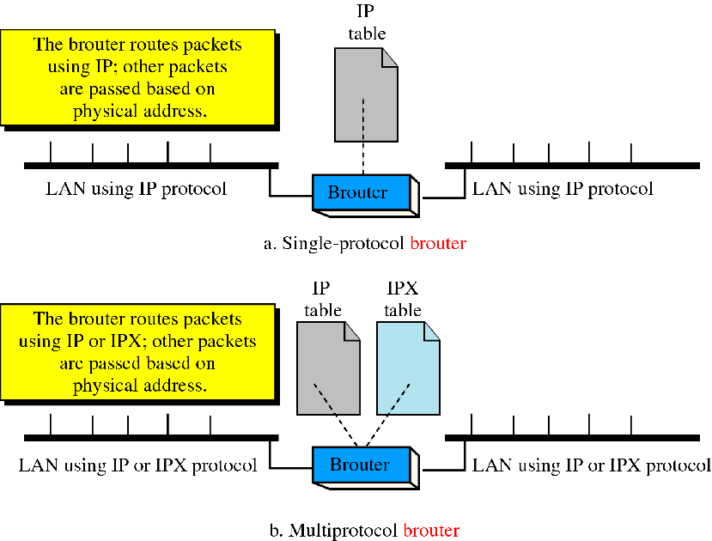
Brouter

Slide 78
Gateways
Interchangeably used term router and gateway
Operates in all 5 layer of the Internet (TCP/IP) and 7 layers of OSI model
A gateway takes an application message, reads it, and interprets it
It translates different protocol suites
A gateway is a combination of hardware and software

Slide 79
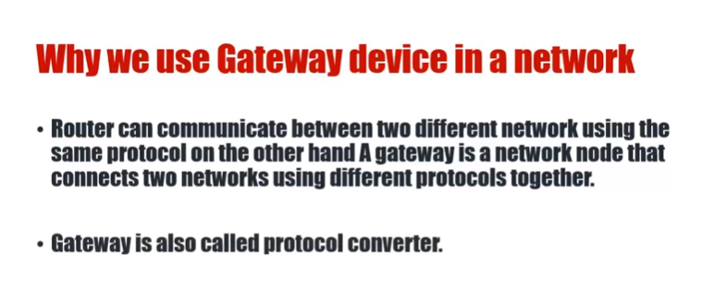

Slide 80
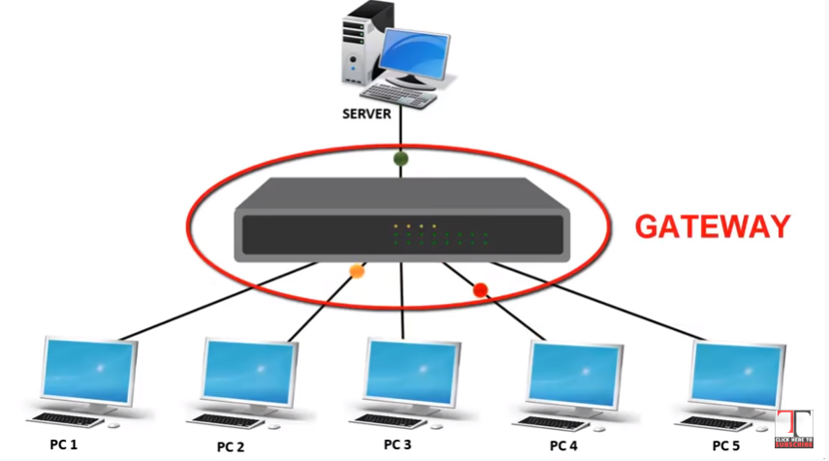

Slide 81
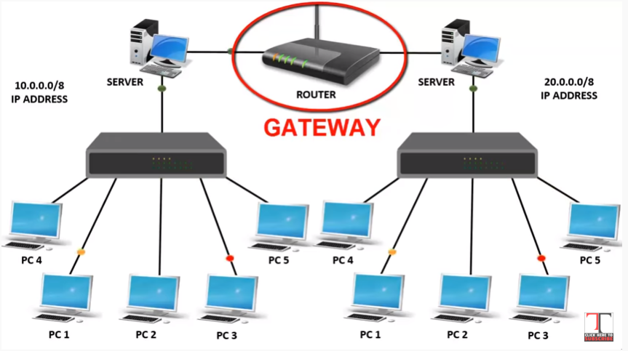

Slide 82
Gateways
A gateway is a network point that acts as an entrance to another network.
On the internet, in terms of routing, the network consists of gateway nodes and host nodes.
Host nodes are computer of network users and the computers that serve contents (such as Web pages).
Gateway nodes are computers that control traffic within your company’s network or at your local internet service provider (ISP)

Slide 83
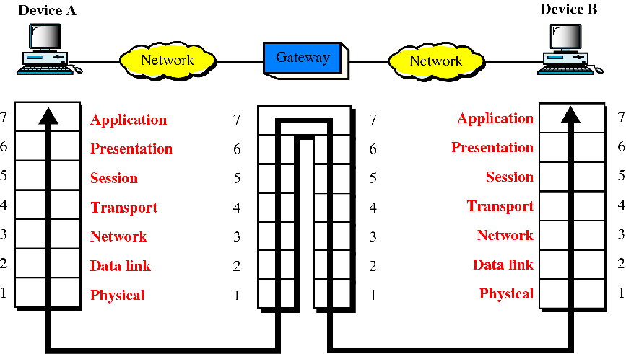
Gateways (protocol converter)

Slide 84
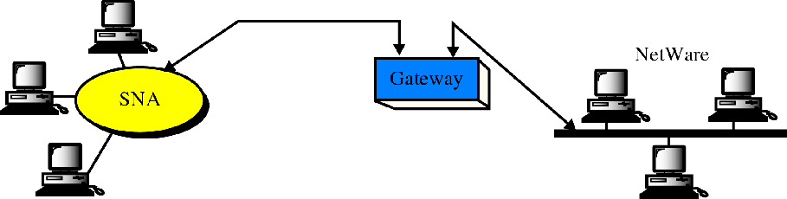
A gateway
SNA network (IBM)
Netware network (Novell)

Slide 85
What is difference between?
Bridge: device to interconnect two LANs that use the SAME logical link control protocol but may use different medium access control protocols.
Router: device to interconnect SIMILAR networks, e.g. similar protocols and workstations and servers
Gateway: device to interconnect DISSIMILAR protocols and servers, like Macintosh and IBM LANs and equipment

Slide 86
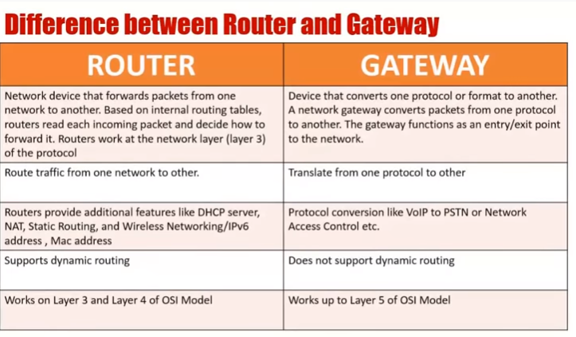

Slide 87
What is difference between?
Switch: device to allow different nodes of a network to communicate directly with each other.
  Allow several users to send information over a network at the same time without slowing each other down.

Slide 88
Summary
Network administrators use devices to control and extend the usable size of a network
These devices include repeaters, hubs, bridges, switches, routers, brouters, and gateways
Repeaters work against attenuation by cleaning and repeating signals that they receive on a network
Repeaters work at the Physical layer of the OSI model
They cannot connect different network architectures

Slide 89
Summary (continued)
Repeaters do not reduce network traffic or segment the network
A hub ties several networking cables together to create a link between different stations on a network
An active hub has its own electrical power and acts as a repeater, whereas a passive hub provides no signal regeneration
Hubs operate at the Physical layer of the OSI model and do not segment the network
Network segmentation is the process of isolating hosts into smaller segments to reduce the possibility of collisions

Slide 90
Summary (continued)
Bridges and switches are two devices commonly used to segment networks
Bridges provide network segmentation by examining the MAC address that is sent in the data frame
Bridges operate at the Data Link layer of the OSI model

Slide 91
Summary (continued)
Switches increase network performance by reducing the number of frames transmitted to the rest of a network
They do this by opening a virtual circuit between the source and the destination
Switches operate at the Data Link layer of the OSI model

Slide 92
Summary (continued)
Routers operate at the Network layer of the OSI model and provide filtering and network-traffic control on LANs and WANs
They can connect multiple segments and networks
On a TCP/IP network, routers use IP addresses to route packets to the correct network segment
Routers use information from routing tables to move packets from one network to another

Slide 93
Summary (continued)
A brouter is a hybrid device that functions both as a bridge for non-routable protocols and as a router for routable protocols
Brouters operate at both the Data Link and Network layers
Gateways are usually a combination of hardware and software and are used to translate between different protocols
They usually operate at layer 4 and above in the OSI model

